Slide 1
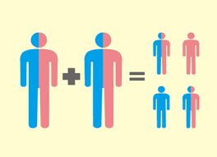
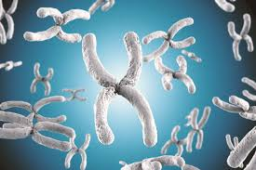
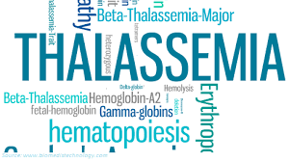
Fertility, Prenatal Diagnosis & Pregnancy in Thalassemia
Prof. Firoza Begum
High Risk Pregnancy & Infertility Specialist
Chairman, Fetomaternal Medicine Dept, BSMMU

Slide 2
Introduction
Hemoglobinopathies are among the most common inherited diseases.
Approximately 7% of the global population is a carrier, and 300,000–500,000 children are born with a severe hemoglobin disorder annually.
The phenotype includes anemia, bone marrow expansion, skeletal deformities, growth restriction, and late sexual maturity.
Weatherall DJ. The inherited diseases of hemoglobin are an emerging global health burden. Blood. 2010;115: 4331–4336.
Danjou F, Anni F, Galanello R. Beta-thalassemia: from genotype to phenotype. Haematologica. 2011;96:1573–1575.
Camaschella C, Cappellini MD. Thalassemia intermedia. Haematologica. 1995;80:58–68.

Slide 3
Cont…..
Advances in the primary care of β-thalassaemia major by optimal blood transfusion and chelation therapy improved patient survival into adulthood.
At the same time, patients’ quality of life has also increased significantly.
And expectation of having a family—an important dimension of quality of life—is consequently an important aspiration for many thalassaemia patients.
Notes:
global Universal Health Coverage Forum dec, 2017, taking place in Tokyo, Japan.

Slide 4
Fertility
Hypogonadotropic hypogonadism (HH) -the commonest endocrinopathy leading to pubertal failure, sexual dysfunction, infertility, and short stature.
51%–66% transfusion dependent thalassemic patients develop marked hemosiderosis resulting in free radical oxidative stress of target organs.
Iron accumulation in anterior pituitary , results in impaired secretion of gonadotropins and growth-hormone .
Iron accumulation in the ovaries or testes create imbalance between the generation of reactive oxygen species and the scavenging capacity of antioxidants in the reproductive tract.
De Sanctis V, Soliman AT, Elsedfy H, et al. Indian J Endocrinol Metab. 2013;17:8–18.
Roussou P et al . Anemia. 2013;2013:617204
Agarwal A, Allamaneni S. Reprod Biomed Online. 2004;9:338–347.
Notes:
global Universal Health Coverage Forum dec, 2017, taking place in Tokyo, Japan.

Slide 5
Fertility --Management
Majority patients has nonpulsatile but functional gonads
Likely to benefit from exogenous gonadotrophin therapy, ‘bypassing’ the H-P axis.
Human chorionic gonadotropin/human menopausal gonadotropin therapy gives 80% success rate
Spermatogenesis in thalassemic males is more difficult to treat, success rate of 10%–15% in moderate to severely iron-loaded patients.
ovulation in females and spermatogenesis in males must be undertaken according to HFEA guidelines.
Skordis N, Petrikkos L, Toumba M, et al. Update on fertility in thalassaemia major. Pediatr Endocrinol Rev. 2004;2:296–302
Notes:
global Universal Health Coverage Forum dec, 2017, taking place in Tokyo, Japan.

Slide 6
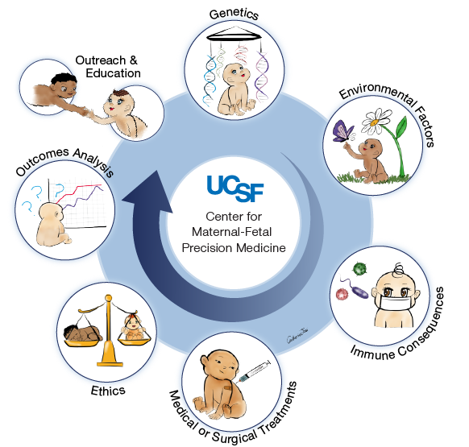
Prevention of Thalassemia
Notes:
global Universal Health Coverage Forum dec, 2017, taking place in Tokyo, Japan.

Slide 7
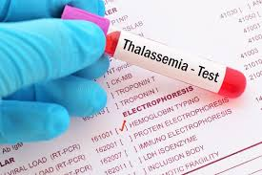
Prevention-Screening:
Thalassemia traits/carriers have reduced MCV, MCH with normal MCHC
Cut off points varies from laboratory to laboratory
MCV < 77 fl and MCH < 27 pgm are ideally suited for further confirmation of carrier state
Hb A2 level is the gold standard for detection of trait : 3.5% is the cut off value
Notes:
global Universal Health Coverage Forum dec, 2017, taking place in Tokyo, Japan.

Slide 8
Prevention-Screening:
Blood smear shows profound microcytic anemia, with extreme hypochromia, tear drop, target cells and nucleated RBCs
Hemoglobin may be very low at 3-4 g/dl
Notes:
global Universal Health Coverage Forum dec, 2017, taking place in Tokyo, Japan.

Slide 9
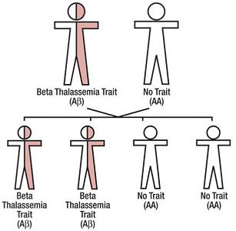
Inheritance
Inheritence
Notes:
Mandelian Recessive manner

Slide 10
Prevention -Carrier detection
Carrier screening can be made available to school going children, high-risk communities, extended family of the affected individual, pre-marital , husband if wife is carrier or routine antenatal screening at 10-1 2 weeks
Screening policy in Cyprus, implemented since1970s (including prenatal screening and abortion) reduced disease from 1 in 158 to almost 0
In Iran - premarital screening - Man’s red cell indices
We must adopt our own policy
Notes:
global Universal Health Coverage Forum dec, 2017, taking place in Tokyo, Japan.

Slide 11
Prevention -Carrier detection
Carrier screening can be made available to school going children, high-risk communities, extended family of the affected individual, pre-marital , husband if wife is carrier or routine antenatal screening at 10-1 2 weeks
Screening policy in Cyprus, implemented since1970s (including prenatal screening and abortion) reduced disease from 1 in 158 to almost 0
In Iran - premarital screening - Man’s red cell indices
We must adopt our own policy
Notes:
global Universal Health Coverage Forum dec, 2017, taking place in Tokyo, Japan.

Slide 12
Detection of Thalassemia in pregnancy
Early detection should be part of good medical practice
Diagnosis of thalasaemia during pregnancy is difficult, iron deficiency also cause microcytosis
low MCV often is the first or only clue
Exclusion of iron deficiency by S. Iron, TIBC & Ferritin
Hb-Electrophoresis – in suspicious cases
Where both parents are found carriers, counseling for prenatal diagnosis should be done
The couple be informed -possibility (25%) of a TM fetus.
Notes:
global Universal Health Coverage Forum dec, 2017, taking place in Tokyo, Japan.

Slide 13
Prevention--Prenatal diagnosis
Needs DNA analysis of foetal cells either by
Amniocentesis (15-18 weeks) or
Chorion villous sampling (11- 13+6 weeks)
Chorionic villus sampling has advantages of early diagnosis during the first trimester
On the contrary, amniocentesis has the drawback of being feasible only after the 15th week.
The risk of miscarriage does not differ between these invasive procedures, and is estimated to be less than 1%
Rosatelli MC, Tuveri T, Scalas MT, et al. Hum Genet. 1992;89:585–589.
Lau KT, Leung YT, Fung YT, Chan LW, Sahota DS, Leung NT. Chin Med J (Engl) 2005;118:1675–1681.
Notes:
global Universal Health Coverage Forum dec, 2017, taking place in Tokyo, Japan.

Slide 14
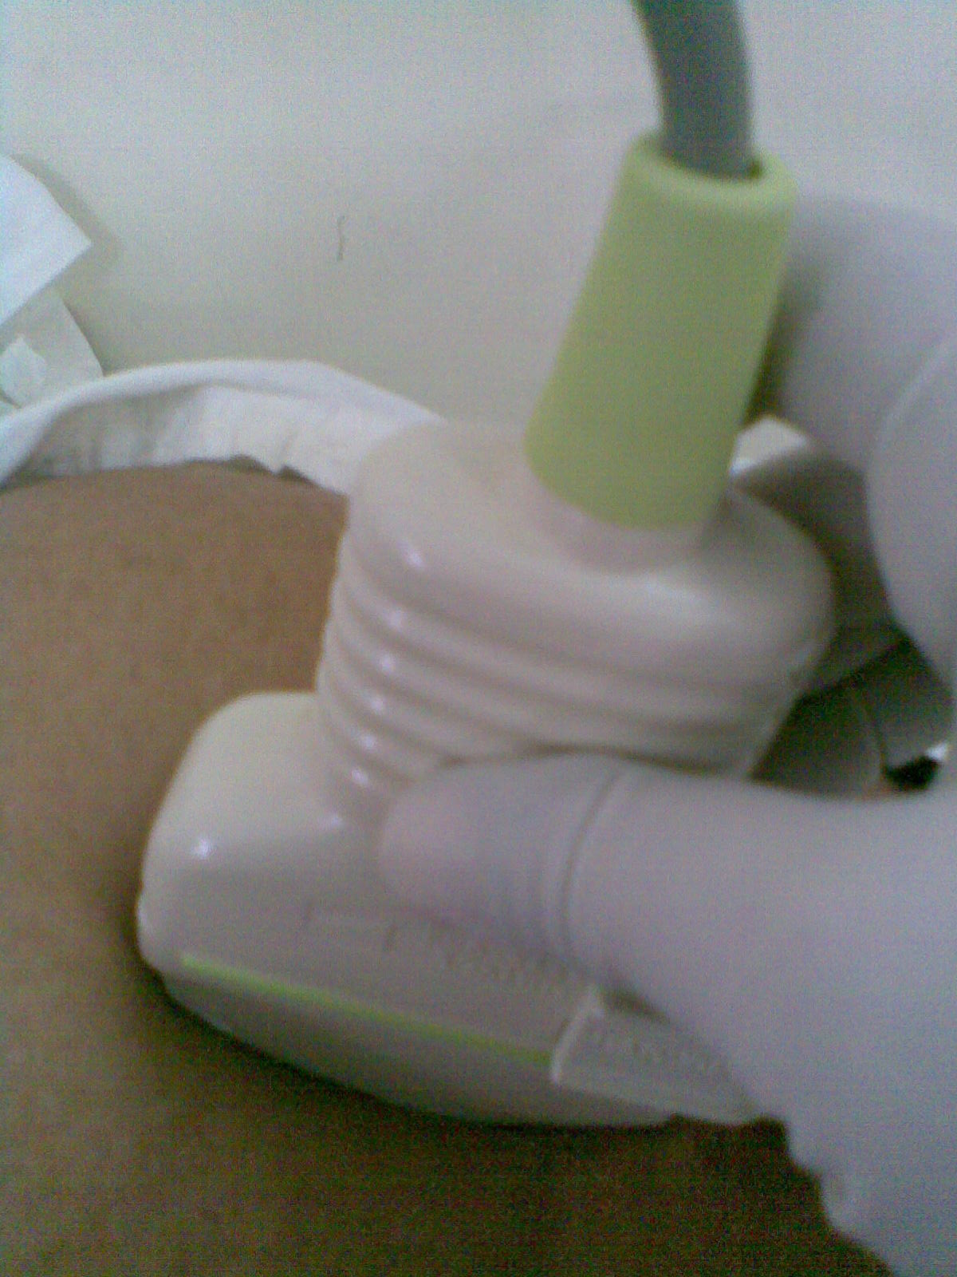
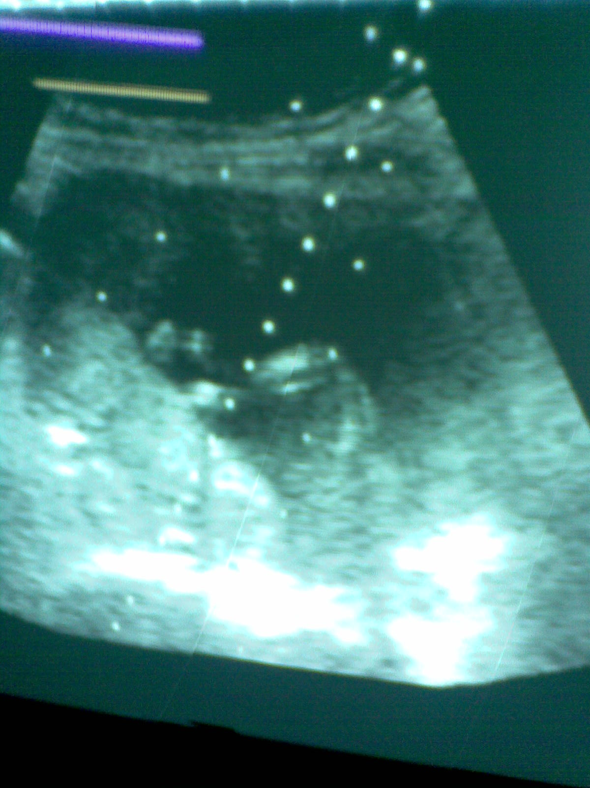
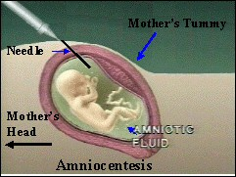
Amniocentesis
Notes:
global Universal Health Coverage Forum dec, 2017, taking place in Tokyo, Japan.

Slide 15
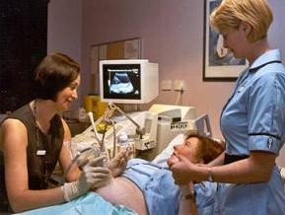
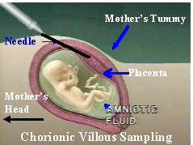
Chorion Villus Biopsy
Notes:
global Universal Health Coverage Forum dec, 2017, taking place in Tokyo, Japan.

Slide 16
Pregnancy in Thalassemia must be planned
Needs management by multidisciplinary team
with
Fetomaternal medicine specialist & haematologist
Notes:
global Universal Health Coverage Forum dec, 2017, taking place in Tokyo, Japan.

Slide 17
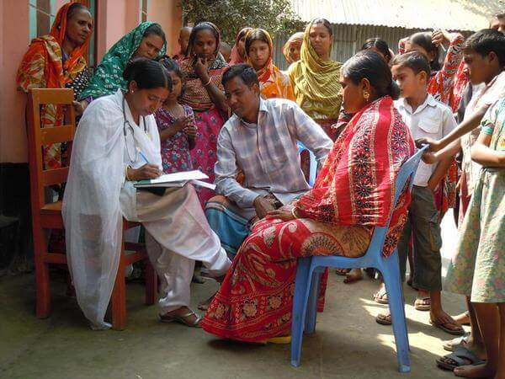
Pre-pregnancy counselling
Has a three-fold purpose-
evaluation of eligibility
physicians to review medications involved
physician/s, patient and partner to discuss the risks associated with induced fertility and pregnancy.
Notes:
global Universal Health Coverage Forum dec, 2017, taking place in Tokyo, Japan.

Slide 18
Prepregnancy planning
Medication review, cardiac function, liver function, screening for endocrinological abnormalities, infection control should be considered in prepregnancy evaluation and during pregnancy management
Hemoglobin concentration must be maintained over 10 g/dL, and chelation must be stopped as soon as pregnancy is diagnosed
Green-top Guideline No. 66 March 2014
Notes:
global Universal Health Coverage Forum dec, 2017, taking place in Tokyo, Japan.

Slide 19
Cardiac assessment
All women should be assessed by a cardiologist with expertise in thalassaemia prior to embarking on a pregnancy
An echocardiogram and ECG performed as well as T2* cardiac MRI
Should undergo specialist cardiac assessment at 28 weeks of gestation and thereafter as appropriate
With normal resting cardiac performance and intensive pre- gestational chelation therapy, gestation and delivery usually carry out successfully.
Lupton M, Oteng-Ntim E, Ayida G, et al. Cardiac disease in pregnancy. Curr Opin Obstet Gynecol. 2002;14:137–143.
Notes:
global Universal Health Coverage Forum dec, 2017, taking place in Tokyo, Japan.

Slide 20
Diet modification
Iron rich foods e.g. meat and non-meat iron avoided
Antioxidants e.g. Vit C, E, vegetable oil, carotinoides (carrots, corn, tomato, papya) and flavinoids (tea) are encouraged
Iron chelators bind with zinc and excreted in urine
Zinc rich foods e.g. dairy products like milk, cheese, yogurt, egg and whole meal cereal are encouraged
Folic acid, calcium, and vitamin D be started
Prevention of neural tube defects: results of the Medical Research Council Vitamin Study. Lancet. 1991;338:131–137.
Leung CF, Lao TT, Chang AM. Effect of folate supplement on pregnant women with β-thalassaemia minor. Eur J Obstet Gynecol Reprod Biol. 1989;33:209–213.
Notes:
Should be advised to modify lifestyle and diet . Iron overload leading to oxidative damage is the centre of all complications
Folic acid supplementation 5 mg/day, to prevent fetal neural tube defects, as well as significant increase in pre delivery Hb level, and in heterozygous cases prevent superimposed megaloblastic anaemia

Slide 21
Medication review
Before pregnancy potential teratogenic medication e.g. oral hypoglycemic agents, bisphosphonates, and ACE inhibitors needs to be reviewed
Medications e.g. interferon, ribavirin, and hydroxyurea should be discontinued at least 6 months prior to fertility treatment
Hypothyroid patients receiving thyroid-replacement therapy should receive increased doses to ensure they are euthyroid.
Tanner MA, Galanello R, Dessi C, Smith GC, Westwood MA, Agus A, Pibiri M, Nair SV, Walker JM, Pennell DJ. Combined chelation therapy in thalassemia major for the treatment of severe myocardial siderosis with left ventricular dysfunction. J Cardiovasc Magn Reson. 2008;10:12. doi: 10.1186/1532-429X-10-12.
Notes:
global Universal Health Coverage Forum dec, 2017, taking place in Tokyo, Japan.

Slide 22
Chelation during pregnancy
Throughout pregnancy, hemoglobin should be maintained to acceptable levels to minimize hypoxia
Aggressive chelation in preconception can reduce and optimize body iron burden and reduce end-organ damage
Oral chelators e.g. deferasirox [DFX] or deferiprone are recommended to switch to desferrioxamine [DFO] prior to induction of ovulation/spermatogenesis
Hepatic iron loading should be carefully reviewed and consideration be given to low dose desferrioxamine iron chelation from 20 weeks
Due to lack of safety data, all chelation therapy should be regarded as potentially teratogenic in the first trimester and must be stopped
Rachmilewitz EA, Giardina P. How I treat thalassemia. Blood. 2011;118:3479–3488
Notes:
global Universal Health Coverage Forum dec, 2017, taking place in Tokyo, Japan.

Slide 23
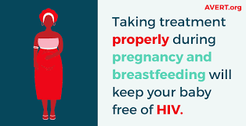
Infection Prophylaxis
Splenectomized women should take penicillin prophylaxis.
HIV-positive women should be advised to commence highly active antiretroviral therapy, deliver by cesarean section (CS) and avoid breast-feeding
HCV-positive women should start appropriate therapy so as to eliminate HCV RNA
Davies JM, Lewis MP, Wimperis J, Rafi I, Ladhani S, Bolton-Maggs PH. prepared on behalf of the British Committee for Standards in Haematology by a working party of the Haemato-Oncology Task Force. Br J Haematol. 2011;155:308–317.
84. Duryea E, Nicholson F, Cooper S, et al. The use of protease inhibitors in pregnancy: maternal and fetal considerations. Infect Dis Obstet Gynecol. 2015;2015:563727.
Notes:
global Universal Health Coverage Forum dec, 2017, taking place in Tokyo, Japan.

Slide 24
Correction of anemia
Thalassemia in combination with physiological gestational anemia often lead to severe anemia
Consequence-IUGR and preterm labor
All women with thalassaemia major should be receiving blood transfusions on a regular basis aiming for a pretransfusion haemoglobin of 10 gm/dl.
Savona-Ventura C, Grech ES. Pregnancy complications in homozygous thalassaemia patients. J Obstet Gynaecol. 1991;11:175–176. Levy A, Fraser D, Katz M, et al. Maternal anemia during pregnancy is an independent risk factor for low birthweight and preterm delivery
Origa R, Piga A, Quarta G, et al. Pregnancy and β-thalassemia: an Italian multicenter experience. Haematologica. 2010;95:376–381
Notes:
global Universal Health Coverage Forum dec, 2017, taking place in Tokyo, Japan.

Slide 25
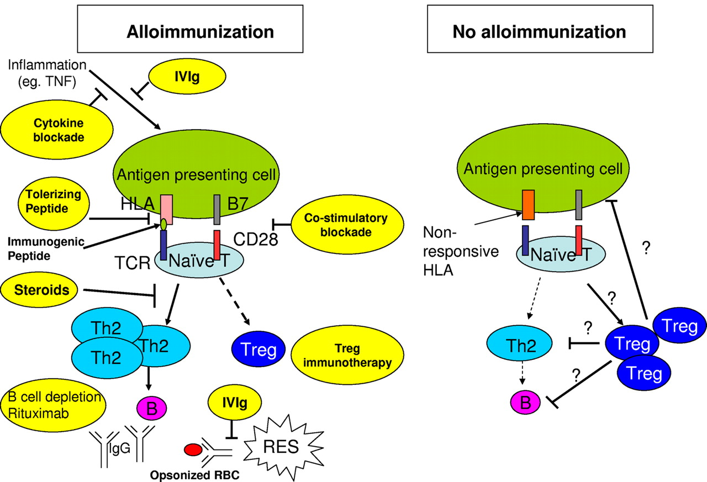
Precautions for Blood Transfusion (BT)
Extended genotype and antibody screening should be performed and fully phenotyped matched blood be given to avoid development of alloantibodies
Hemolytic alloantibody and erythrocyte-autoantibody development complicates transfusion therapy in thalassemia patients
One single unit transfusion can cause red blood-cell alloimmunization in 1%–1.6% cases
In patients receiving regular BT, chance may be as high as 60%
Alloantibodies cross placenta and can cause fetal and/or neonatal hemolytic anemia making extended genotype and antibody screening necessary before transfusion
Thompson AA, Cunningham MJ, Singer ST, et al. Red cell alloimmunization in a diverse population of transfused patients with thalas-saemia. Br J Haematol. 2011;153:121–128.
Kosaryan M, Mahdavi MR, Roshan P, et al. Prevalence of alloimmunisation in patients with β thalassaemia major. Blood Transfus. 2012;10:396–397. Chou ST, Liem RI, Thompson AA. Challenges of alloimmunization in patients with haemoglobinopathies. Br J Haematol. 2012;159:394–404.
Notes:
global Universal Health Coverage Forum dec, 2017, taking place in Tokyo, Japan.

Slide 26
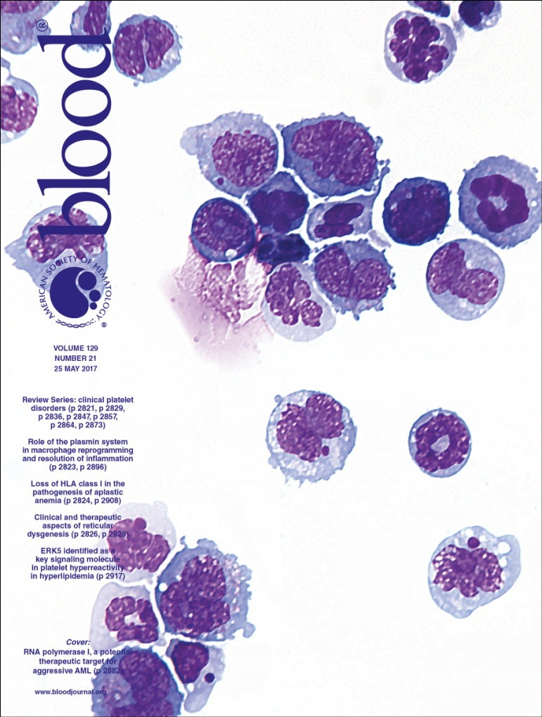
Thromboprophylaxis
Women with TM or TI have thrombotic tendency due to presence of abnormal red cell fragments, especially in splenectomized patient.
Combined with high platelet count it significantly increases the risk of venous thromboembolism.
Splenectomized women or those with a serum platelet count above 600×10⁹/L should be offered LMW heparin thromboprophylaxis as well as low-dose aspirin (75 mg/day)
Bajoria R, Chatterjee R. Current perspectives of fertility and pregnancy in thalassemia. Hemoglobin. 2009;33:S131–S135. Xu TT, Zhou F, Deng CY, et al. Low-dose aspirin for preventing preeclampsia and its complications: a meta-analysis. J Clin Hypertens (Greenwich) 2015;17:567–573.
Notes:
global Universal Health Coverage Forum dec, 2017, taking place in Tokyo, Japan.

Slide 27
Intrapartum management
Senior midwife, Fetomaternal medicine specialist , anaesthetic and haematology staff should be informed as soon as the woman is admitted .
In the presence of red cell antibodies, blood should be cross-matched for delivery.
Transfusion-dependent women that are not chelated will have high concentrations of non-transferrin-bound iron in the serum , which can cause cardiac dysrhythmias in combination with labor stress.
Intravenous DFO 2 g over 24 hours is recommended for the duration of labor.
Lekawanvijit S, Chattipakorn N. Iron overload thalassemic cardiomyopathy: iron status assessment and mechanisms of mechanical and electrical disturbance due to iron toxicity. Can J Cardiol. 2009;25:213–218.
Notes:
global Universal Health Coverage Forum dec, 2017, taking place in Tokyo, Japan.

Slide 28
Cont…..
Labour & Postpartum management
Uncomplicated disease course –not indication for C/S.
Most cases need CS for cephalopelvic disproportion and skeletal deformities combined with normal fetal growth.
To minimize blood loss AMTSL is recommended
During the postpartum stage, there is high risk of venous thromboembolism
Low-molecular-weight heparin prophylaxis should be administered in hospital followed by a 7-day post discharge regimen after vaginal delivery or a 6-week regimen after C/S
Breastfeeding is safe and should be encouraged
Green-top Guideline No. 66 March 2014
Notes:
global Universal Health Coverage Forum dec, 2017, taking place in Tokyo, Japan.

Slide 29
Take Home Message
Advances in chelation therapy along with regular transfusions have introduced a new era for the thalassemic population-
Increasing the average life span and rendering the perspective of reproductive capacity attainment and creation of a family.
Like innumerable joys many challenges embark in this journey.
Pregnancy in TM and TI should be considered a high-risk pregnancy, although gestation can be completed safely for both mother and fetus as long as pregnant women follow close screening.
Need consultation by qualified team of thalassemia experts- before and throughout pregnancy.
Notes:
global Universal Health Coverage Forum dec, 2017, taking place in Tokyo, Japan.

Slide 30
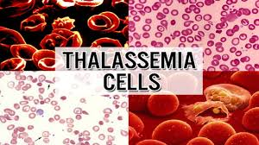
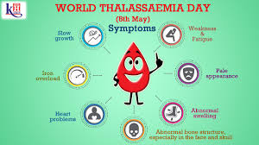
Notes:
global Universal Health Coverage Forum dec, 2017, taking place in Tokyo, Japan.

Slide 31
Iron Chelation
Desferrioxamine is the only chelation agent with evidence for use in the second and third trimester.
Chelation in second and third trimester is important as ongoing iron accumulation from transfusion can expose the women to new complications related to iron overload, particularly diabetes and cardiomyopathy.
Under guidance of an haematologist with experience in iron chelation therapy chelation should be tailored according to the needs of the individual woman.
Rachmilewitz EA, Giardina P. How I treat thalassemia. Blood. 2011;118:3479–3488
Notes:
global Universal Health Coverage Forum dec, 2017, taking place in Tokyo, Japan.

Slide 32
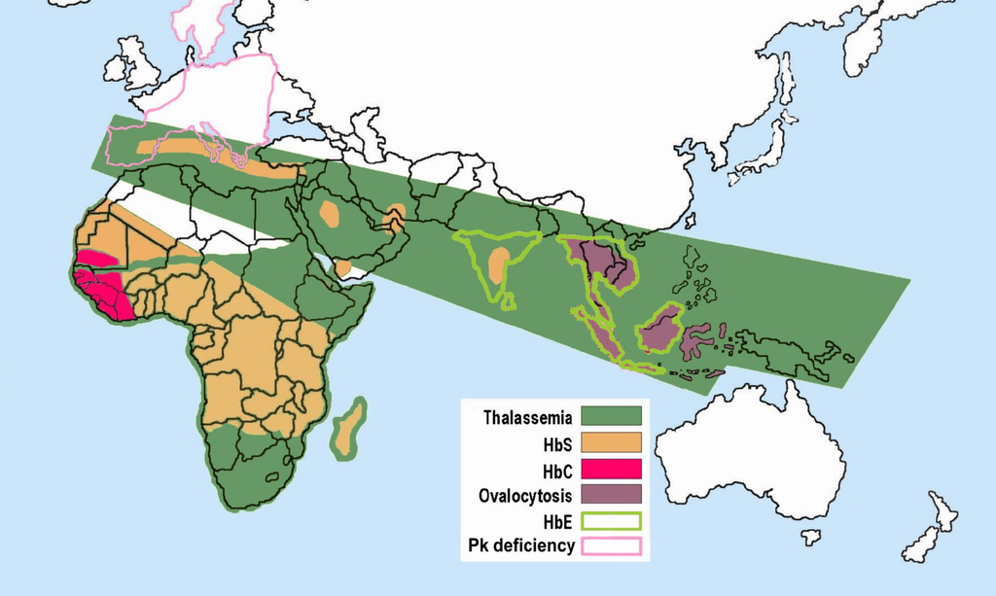
Distribution of red blood cell abnormalities worldwide
In Bangladesh according to the WHO :
3.0% of the populations are carriers of
β –thalassaemia
4.0% are carriers of Haemoglobin-E
Ref: World Health Organization. WHO Fact Sheet 2002; 138.

Slide 33
Antenatal care
Multidisciplinary team involving Fetomaternal Medicine specialist & Haematologist should provide routine as well as specialist antenatal care.
Green-top Guideline No. 66 March 2014
Notes:
global Universal Health Coverage Forum dec, 2017, taking place in Tokyo, Japan.

